Slide 1



Estimating the Effects of Operational Strategies on Travel-Time Reliability for Smart Mobility
Eil Kwon and Chongmyung Park
University of Minnesota Duluth
Avinash Sankarasetty, Kaushik Ayinala, and Sejun Song
School of Computer and Engineering (SCE)
University of Missouri - Kansas City, USA

Slide 2
Outline
Background
Research Objectives
Development of Travel-Time Reliability Estimation System (TeTRES)
TeTRES Case Studies
Future Work

Slide 3
Background
Smart City Infrastructures
Smart
Mobility
Smart
Utilities
Smart
Buildings
Smart
Governance
Efficient, Safe and Environmentally Friendly Mobility Service
A ‘Reliable’ Roadway Network
‘Travel-Time Reliability’ => A Key Performance Measure of
Smart Mobility Service

Slide 4
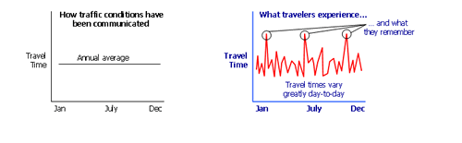
Average Travel Time
Most travelers are less tolerant of unexpected delays and tend to remember the few bad days
Most concern of travelers, cannot be measured by simple ‘Average’
How traffic conditions have been communicated
What travelers experience …
… and what they remember
Travel Time
Annual average
Travel Time
Travel times vary greatly day-to-day
Jan July Dec
Jan July Dec
“Travel Time Reliability presents the consistency or dependability in Travel Times, as measured from day-to-day and/or across different times of the day.”
Source: FHWA, US DOT

Slide 5
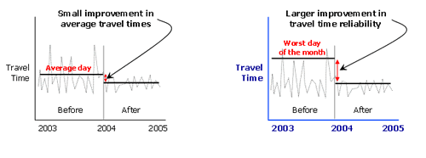
Travel Time Reliability
Measures the extent of ‘unexpected delay’
Captures the benefit of transportation system management/operations
Reflects the improvements of worst conditions
Small improvement in average travel times
Large improvement in travel time reliability
Travel Time
Travel Time
2014 2015 2016
2014 2015 2016
Source: FHWA, US DOT

Slide 6
Measuring Travel Time Reliability
Considering unexpected delays
90th or 95th percentile travel times estimates how bad delay will be on specific routes during the heaviest traffic days.
Buffer index is the additional time
Travelers must add to their average travel time when planning trips to ensure on-time arrival 95 percent of the time.
i.e., 95 percent average travel time is 20 min, buffer index is 40 percent, then buffer time is 8 min → 28 mins.
Planning time index represents how much total time
A traveler should allow to ensure on-time arrival.
i.e., free-flow travel time is 15 min, planning time index is 1.6, then planning time is 8 min → 24 mins.

Slide 7
Research Objectives
Building a framework to estimate and analyze travel-time reliability for given corridors/time periods by applying various unexpected delays
Integration of traffic, incident, weather, work zone, special event, and snow maintenance condition
Automation of processes for data collection, reliability estimation, reporting functions
Support for driver information system by providing expected, e.g., 95th %-ile, travel time for user-selected corridors

Slide 8
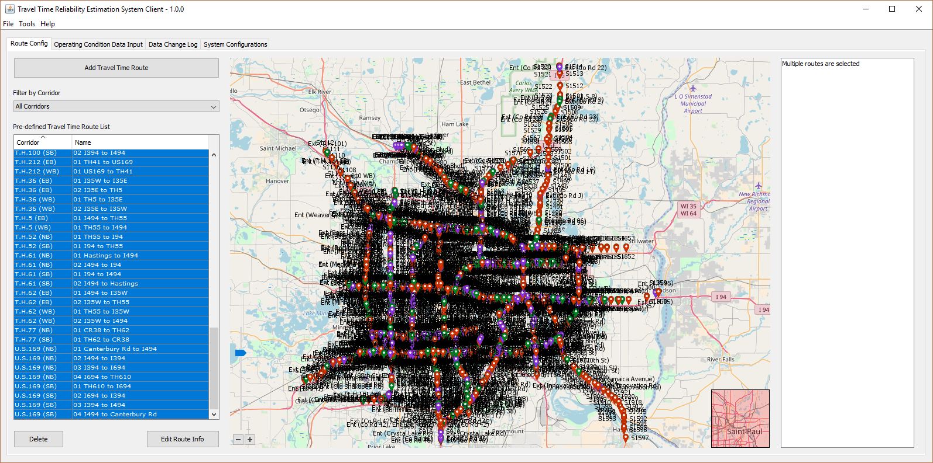
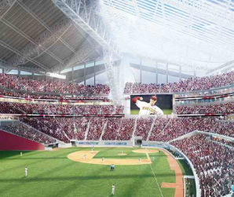
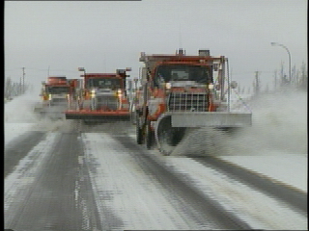
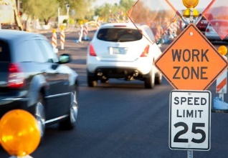
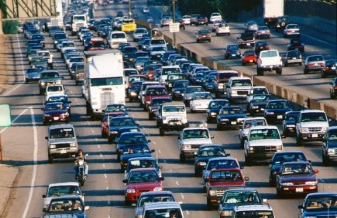
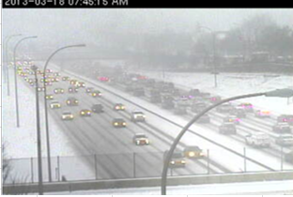
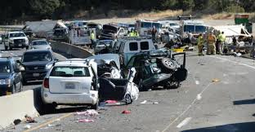
Travel-Time Reliability Estimation / Analysis System (TeTRES)
Special Event
Road Surface Condition
Work zone
Demand Variations/Geometry
Weather
Incident

Slide 9
Vehicle Trajectory Identification with the Speed Data from Loop Detectors
Space
Travel Time from Station 1 to Station 4 at t₀
Station 4
Station 3
d_{2,3} / 3
u₃
d_{2,3}
d_{2,3} / 3
(u₂+u₃)/2
d_{2,3} / 3
u₂
Station 2
traffic flow
direction
Station 1
t₄
t₀
t₁
t₂
t₃
t₅
Time

Slide 10
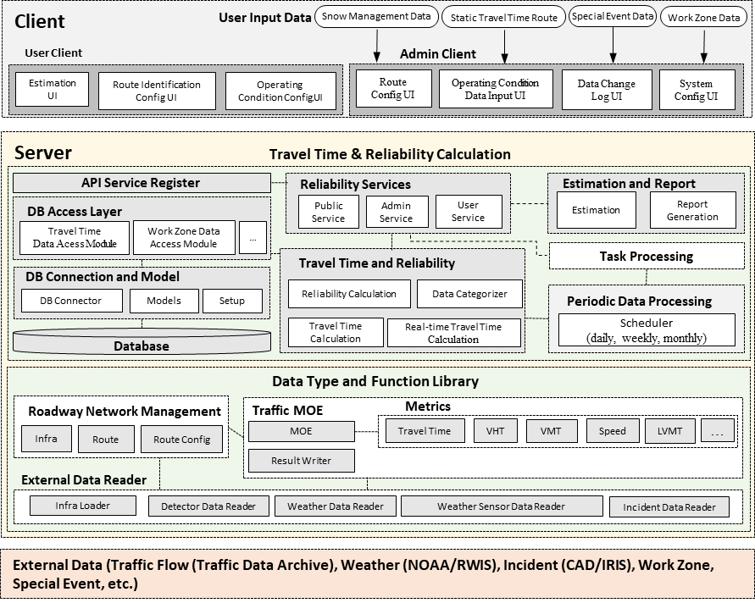
TeTRES System Architecture
Identifying the Effects of Individual or Combined Factors on Reliability
=> Critical in Developing Effective Operations/Planning Strategies

Slide 11
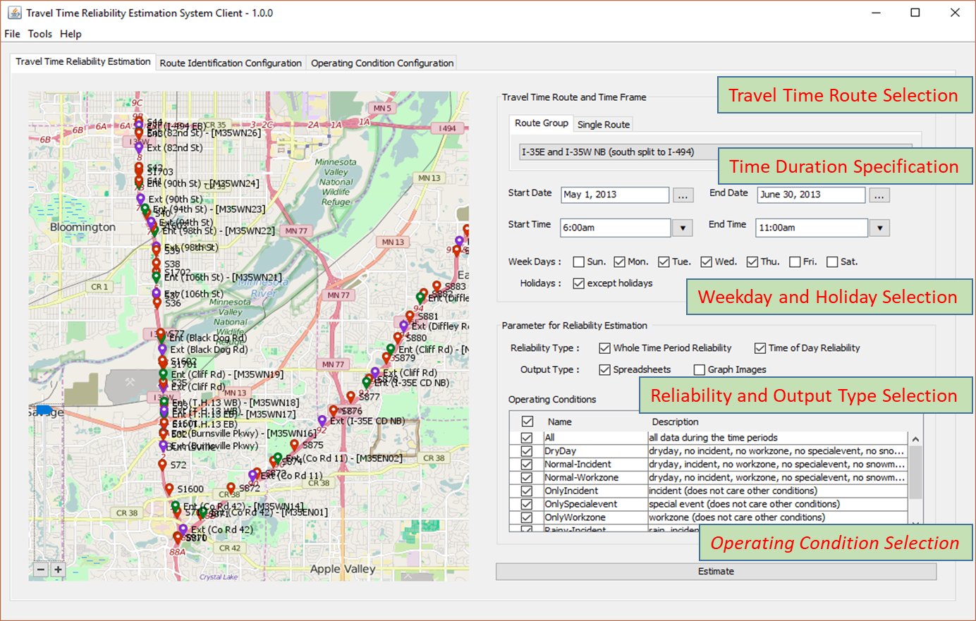
Travel-Time Reliability Estimation Client Panel

Slide 12
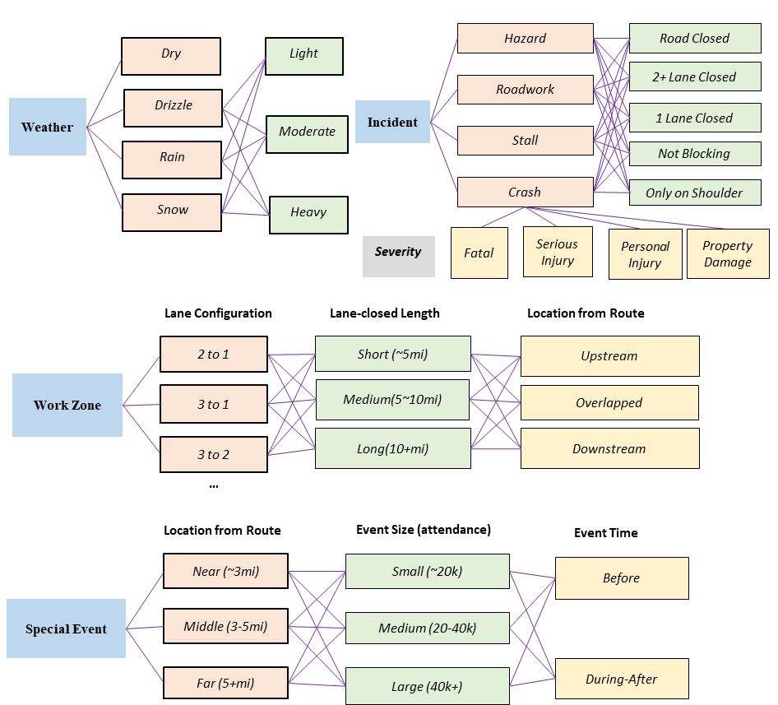
Applying Unexpected Conditions to Reliability

Slide 13
Case Studies
TeTRES case studies on Minnesota Network to estimate effects of operational changes on reliability measures
Case 1: Effects of adaptive ramp metering strategy on corridor reliability
Case 2: Effects of aggressive incident management on corridor / network reliability

Slide 14
Case 1: Ramp metering effect
Effects of Adaptive Ramp Metering on Corridor Reliability
(169 SB, Twin Cities, Minnesota)
* Planning Time Index = 95th %ile TT / Free-Flow TT

Slide 15
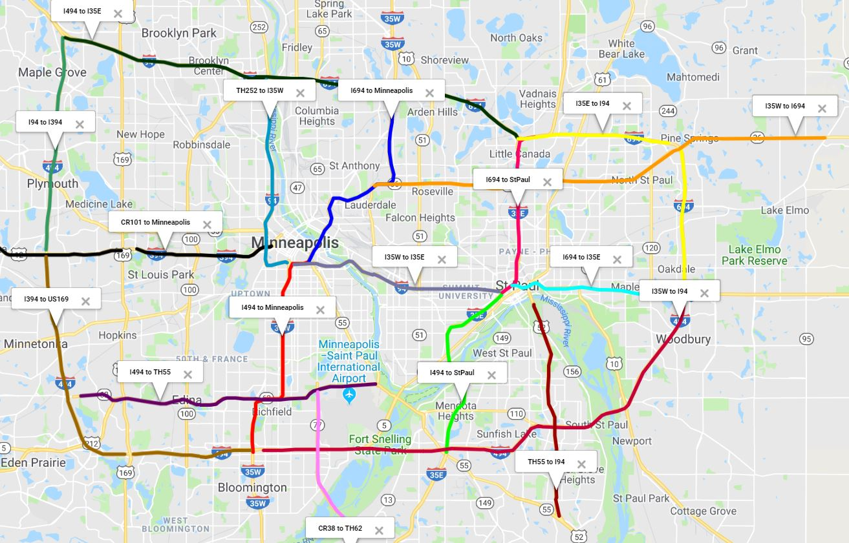
Case 2: Aggressive incident management effect
Corridor reliability during 2018 Super-Bowl Period, Minneapolis, Minnesota

Slide 16
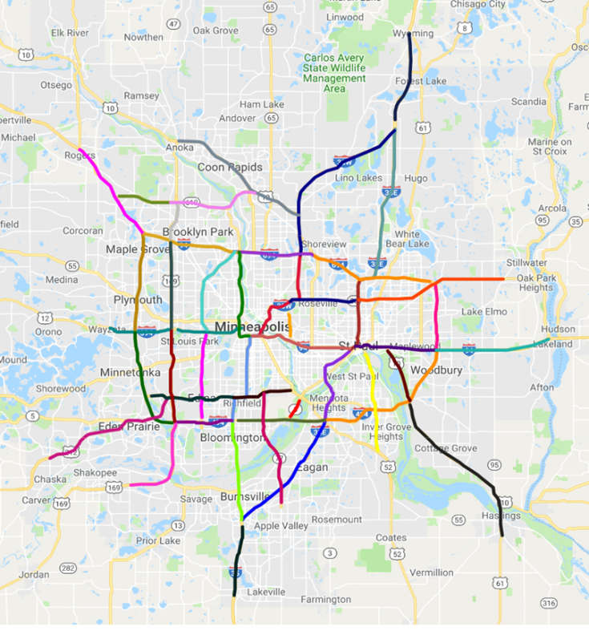
Case 2: Aggressive incident management effect
Network-wide Reliability Variations during Super-Bowl Period

Slide 17
Work in Progress
Full automation of data input process
e.g., work-zone lane-configuration data
Identification and modeling of causal relationships between reliability and geometric/operational changes on a corridor and network level
Development of measures for corridor/network-wide operational resiliency

